Slide 1
Resume challenge CODE BASICS
DHANUSH KUMAR

Slide 2
INTRODUCTION
AtliQ Mart is a growing FMCG manufacturer headquartered in Gujarat, India. It is currently operational in three cities Surat, Ahmedabad and Vadodara. They want to expand to other metros/Tier 1 cities in the next 2 years

Slide 3
Problem statement
Few key customers did not extend their annual contracts due to service issues.
Potential Reason : It is speculated that some of the essential products were either not delivered on time or not delivered in full over a continued period, which could have resulted in bad customer service.

Slide 4
BUSINESS TERMS
Orders are nothing but a unique request placed by a customer on a given date Within an order, a customer could request multiple items. Each of these items requested within the order is called an order line
Line Fill Rate : How many lines they shipped out of the total lines ordered.
Volume Fill rate : The total quantity they are able to ship for a customer per order or for a given period of time
ON – Time (OT) : It determines if an order is delivered as per the agreed time with the customer.
IN-Full (IF): It determines If an order is delivered in full as per the requested quantity by the customer.
ON Time – IN Full (OTIF) : It determines if an order is delivered BOTH in full and On Time as per the customer order request.

Slide 5
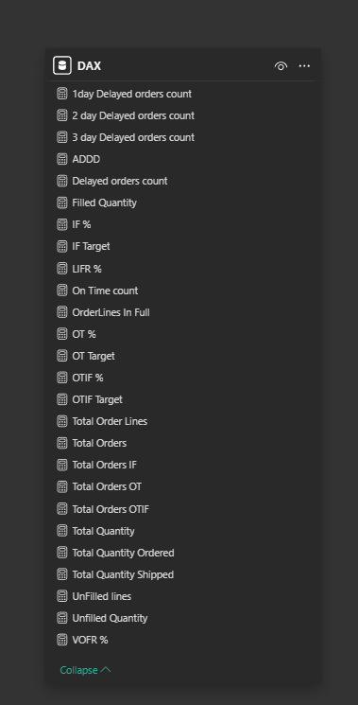
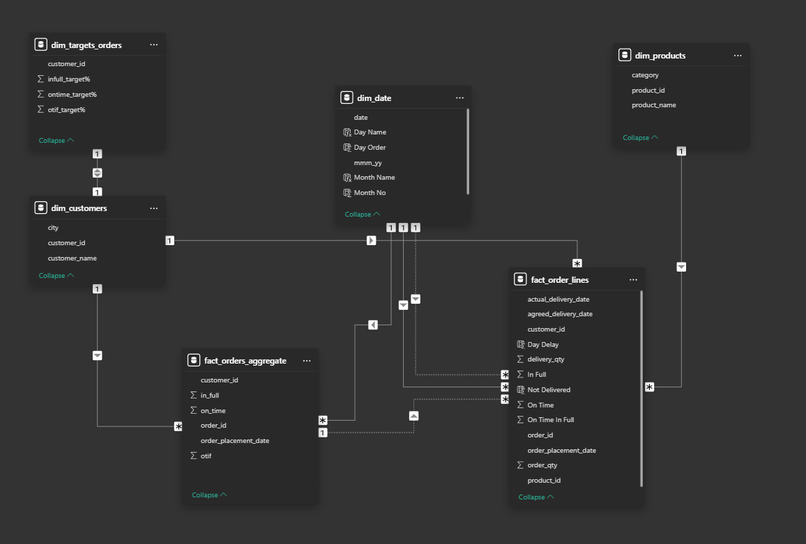
DATA MODEL & dax used

Slide 6
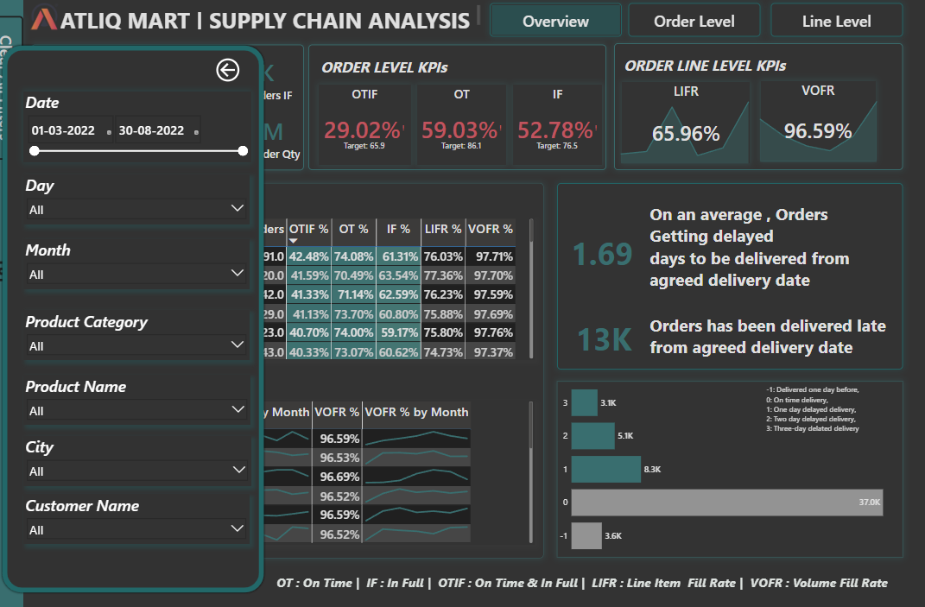
Filters :
Purpose: Filters allow us to slice and dice our data to uncover specific issues and trends.
Key Filters:
Date: Analyze performance over time (seasonal trends).
Month/Day: Pinpoint specific time-based issues.
Product Category/Name: Identify product-specific problems.
City: Compare regional performance.
Customer Name: Assess individual customer service.

Slide 7
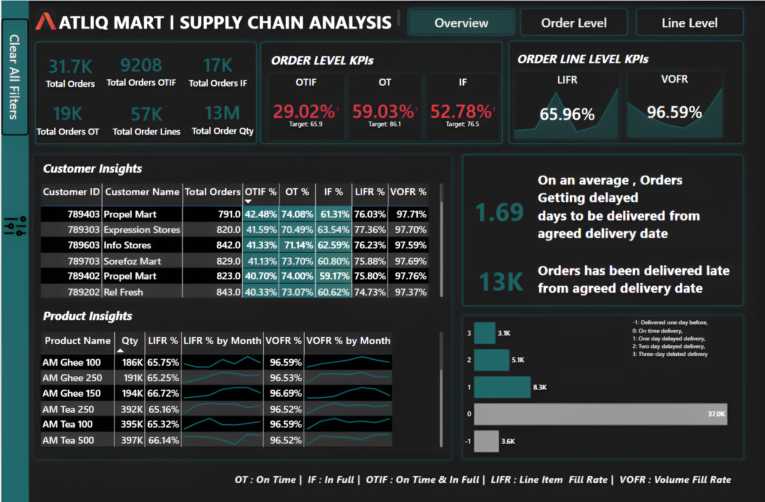
What it Shows:
Overall supply chain performance at a high level.
Key performance indicators (KPIs) like OTIF, OT, and IF.
Delivery delay analysis.
Customer-level performance.
Visualizations Used:
Large KPI number displays.
Bar charts for delay analysis.
Tables for customer performance metrics.
Key Insights:
Critically low OTIF (29.02%) indicating major issues.
Significant delivery delays, particularly 3+ days.
Consistent low OTIF across all customers (6% to 42%)
High VOFR suggesting quantity accuracy when shipped(92% to 97%)

Slide 8
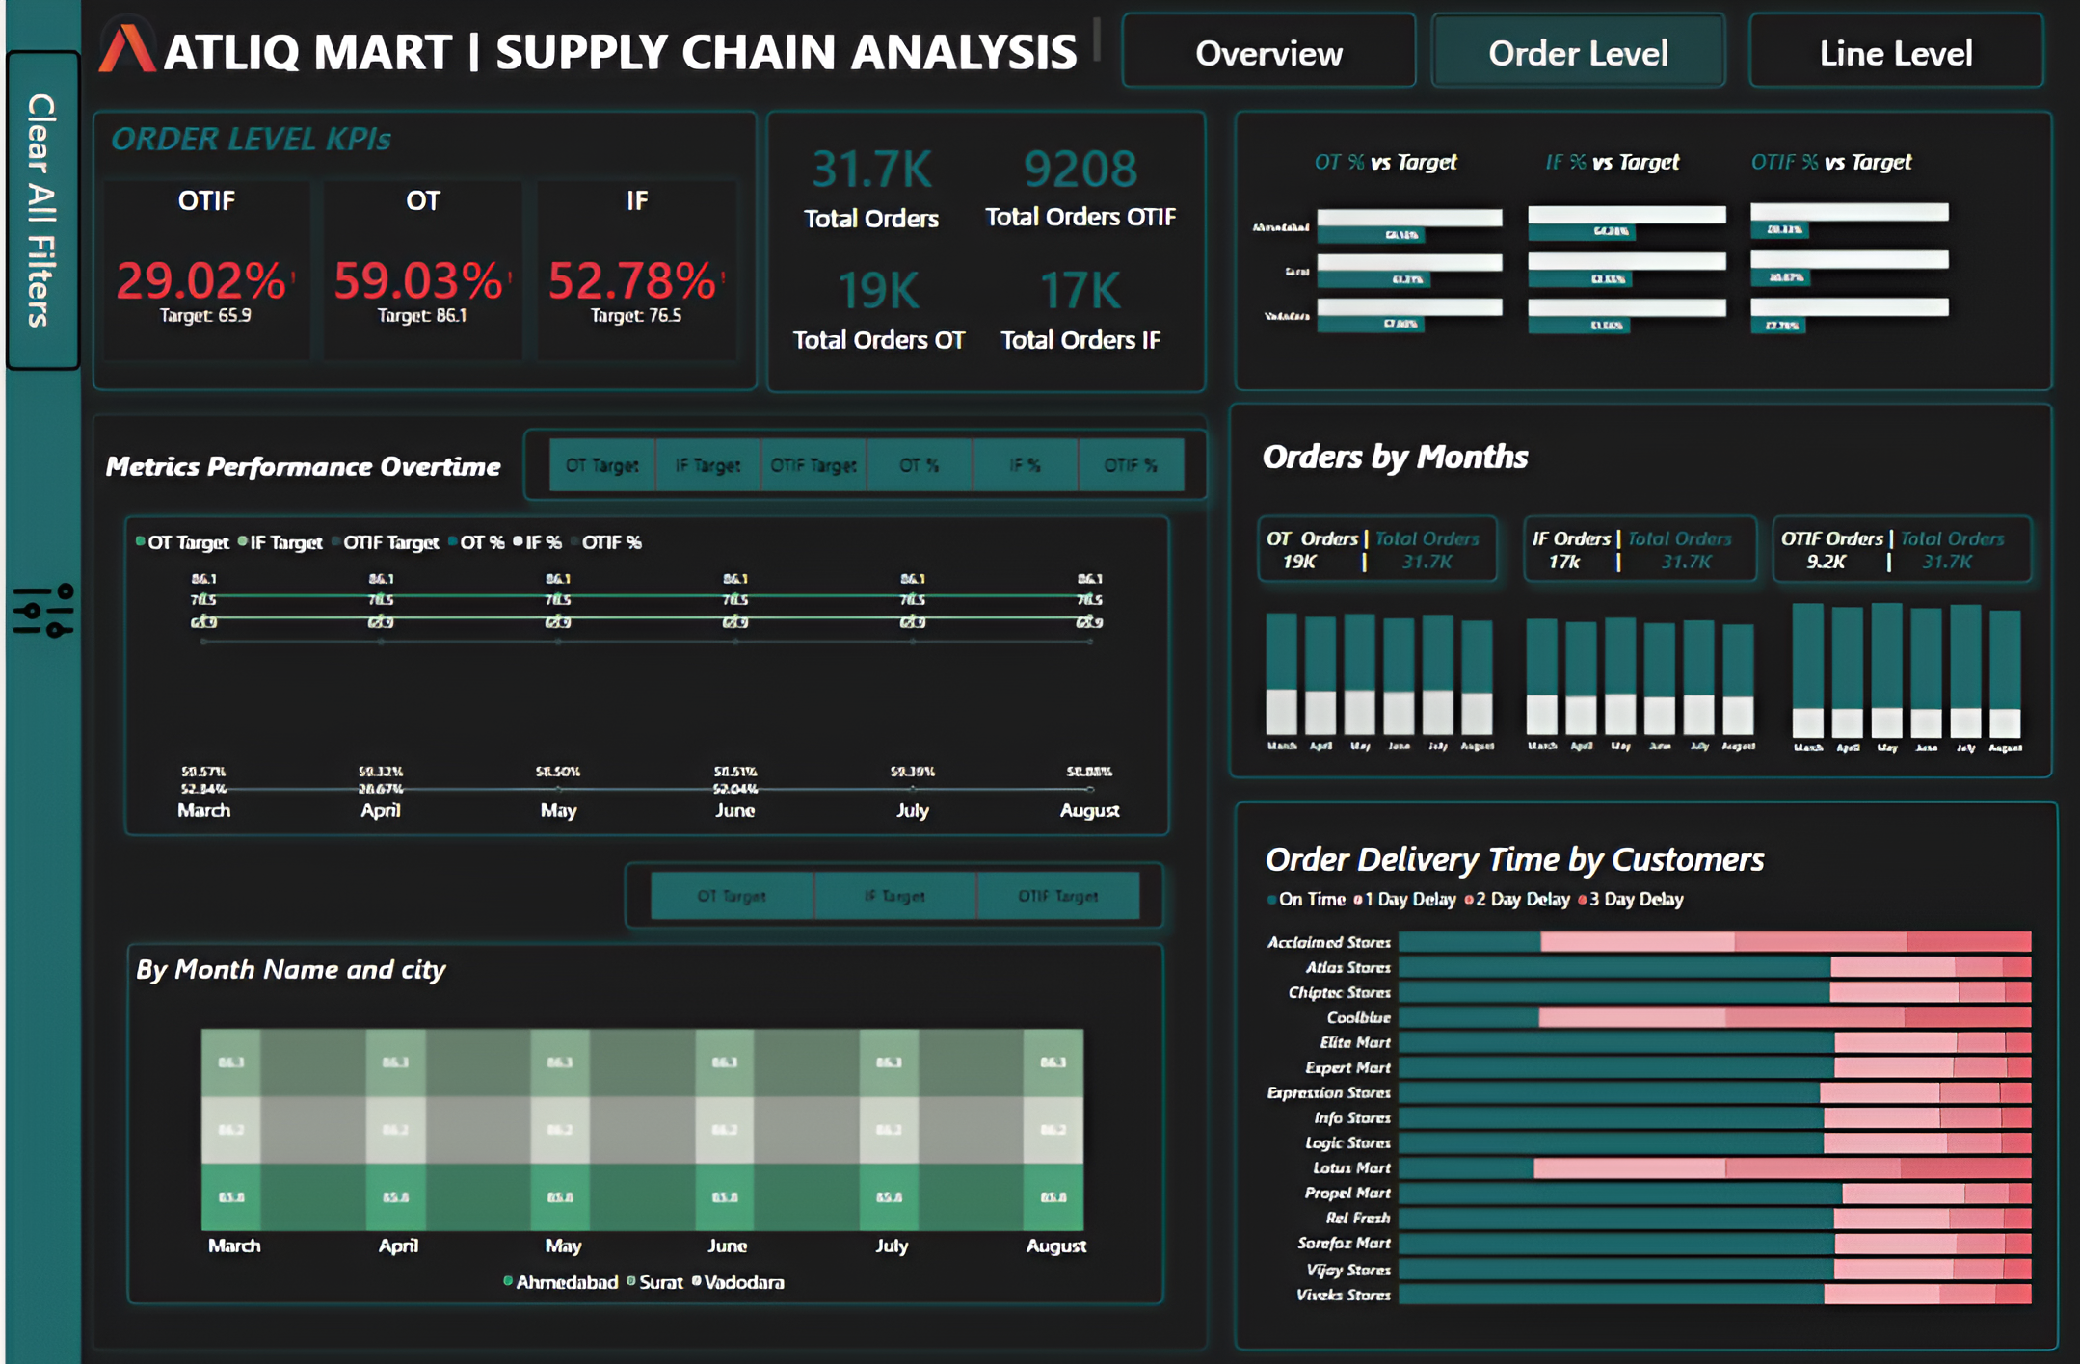
What It Shows
Detailed analysis of order-level KPIs over time.
Comparison of actual performance against targets.
Order volume trends by month.
Customer-specific delivery time breakdowns.
Regional performance comparison.
Visualizations Used:
Line charts for KPI trends over time.
Stacked bar charts for order volume by month.
Stacked bar charts for customer delivery times.
Stacked bar chart for city performance.
Simple bar charts for KPI versus target.
Key Insights:
Consistent low OTIF throughout the analyzed period.
Fluctuations in performance metrics over time.
Varied delivery performance across different customers.
Visual comparison of KPI actuals vs targets showing large gaps.

Slide 9
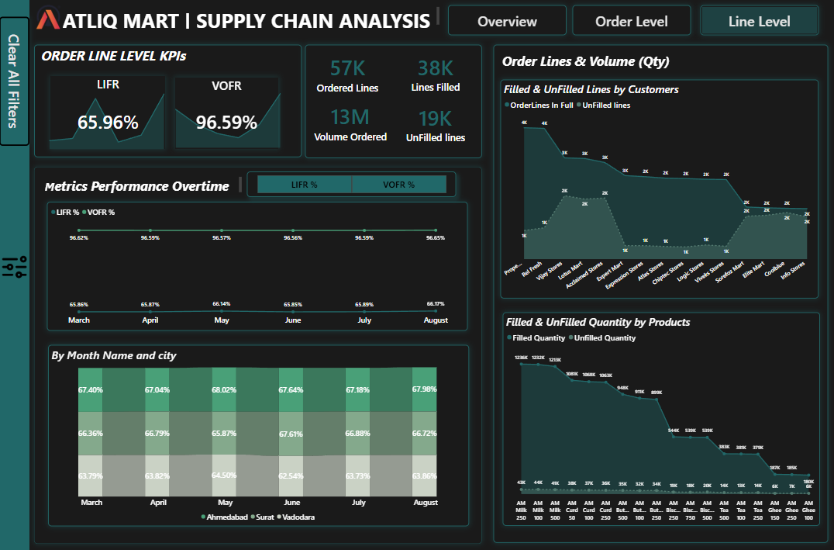
What It Shows:
Analysis of line-item fulfillment and volume metrics.
LIFR and VOFR performance over time.
Filled and unfilled lines by customer.
Filled and unfilled quantities by product.
Regional performance comparison.
Visualizations Used:
Large KPI number displays.
Line charts for LIFR and VOFR trends.
Area charts for filled and unfilled lines/quantities.
Stacked bar chart for city performance.
Key Insights:
Low LIFR (65.96%) indicating issues with fulfilling all order lines.
Stable and high VOFR, indicating accuracy in shipped quantities.
Customer-specific variations in unfilled lines.
Product-specific variations in unfilled quantities.
Regional differences in performance across cities.

Slide 10
1. Address Critical LIFR (Line Item Fill Rate) Deficiency
Issue: LIFR is at 65.96%, indicating major fulfillment inefficiencies. Solution:
Conduct a root cause analysis focusing on inventory accuracy, order processing, and warehouse operations.
Implement corrective actions to improve fulfillment rates and reduce unfilled orders.
2. Improve Customer-Specific Line Item Fulfillment
Issue: High variations in unfilled lines across different customers. Solution:
Analyze customer order patterns and fulfillment challenges.
Allocate dedicated inventory for key customers and improve product availability communication.
Offer alternative product suggestions or order consolidation to minimize unfulfilled lines.
3. Address Product-Specific Fulfillment Challenges
Issue: Certain products have a higher unfilled rate, affecting availability. Solution:
Conduct a detailed inventory analysis of underperforming products.
Optimize supplier reliability, lead times, and stock levels to meet demand.
Adjust safety stock and explore diversified supplier options.

Slide 11
4. Mitigate Regional Disparities in Fulfillment
Issue: Fulfillment performance varies across different cities (Ahmedabad, Surat, Vadodara). Solution:
Investigate operational bottlenecks in underperforming regions.
Optimize inventory distribution and transportation routes to ensure timely deliveries.
Identify and standardize best practices across different locations.
5. Enhance Inventory Management Practices
Issue: Low LIFR and fulfillment challenges indicate inventory inefficiencies. Solution:
Implement real-time inventory tracking and management systems.
Improve demand forecasting accuracy to better align stock with customer needs.
Conduct regular cycle counts to maintain stock accuracy and reduce discrepancies.
6.. Improve Communication & Transparency
Issue: Unfilled lines and fulfillment delays impact customer satisfaction. Solution:
Provide real-time order tracking and updates to customers.
Enhance communication on product availability and potential delays.
Establish a structured process for handling customer inquiries and complaints effectively.

Slide 12
THE END

